Slide 1
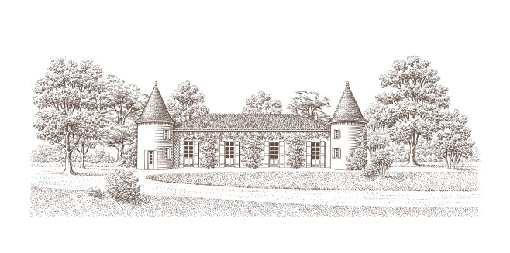
BLANC LIQUOREUX 2015
AOC Cadillac
Location : The vineyard is located in the Cadillac Côtes de Bordeaux appellation, and encompasses 66 hectares. The vines, planted in gravel and clay « terroir », benefits from favorable south-south-east facing slopes and plateaus.
Cultivation : Organic winegrowing
Grape varieties: 50% Sauvignon – 50% Sémillon
Density : 5000 feet/ha
Vinification : Selective hand picking . Pneumatic pressing, fermentation in thermoregulated stainless steel tanks.
Ageing : 15 months ageing in 100% french oak barrels.
Production : 5800 bottles of 50 cl
Dégustation : With a beautiful golden yellow, this 2015 vintage reveals aromas of candied fruit, gingerbread and vanilla. A subtile balance between tasty mellow and elegant oakiness offers a wine with aromas of pineapple and citrus, ample and persistant, characterized by a beautifull freshness. A « gourmet » Cadillac that will be enjoyed today and for many years
Serving temperature: 10°-12° C
Bottle life : 10 ans

